Slide 1
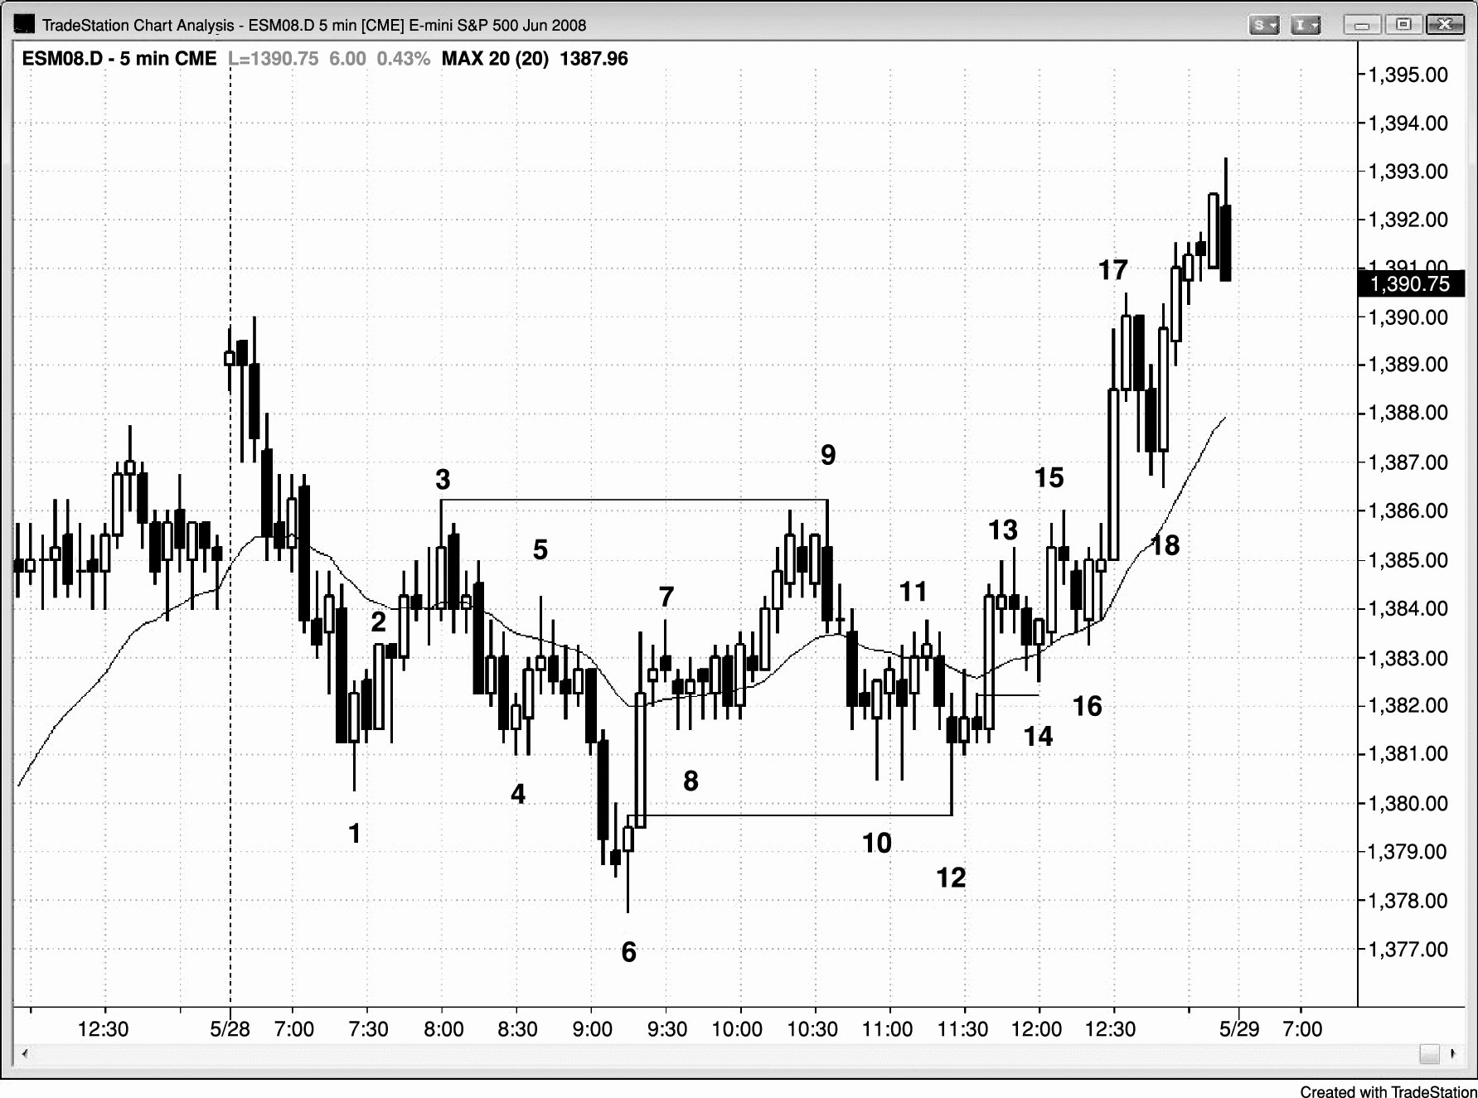
FIGURE 16.1 Two-Legged Moves

Slide 2
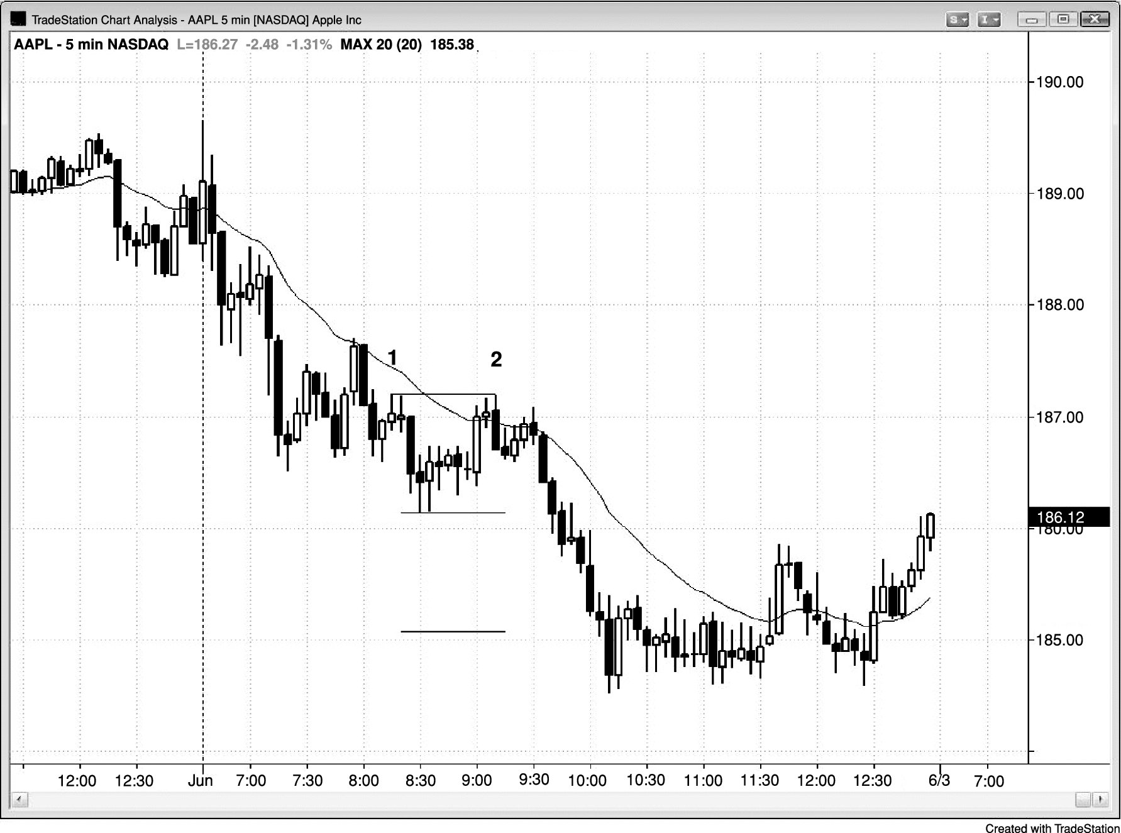
FIGURE 16.2 Double Top Bear Flag

Slide 3
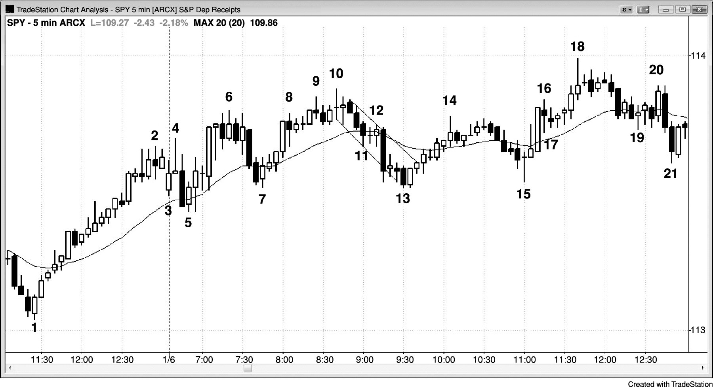
FIGURE 16.3 Wedge Top

